Slide 1
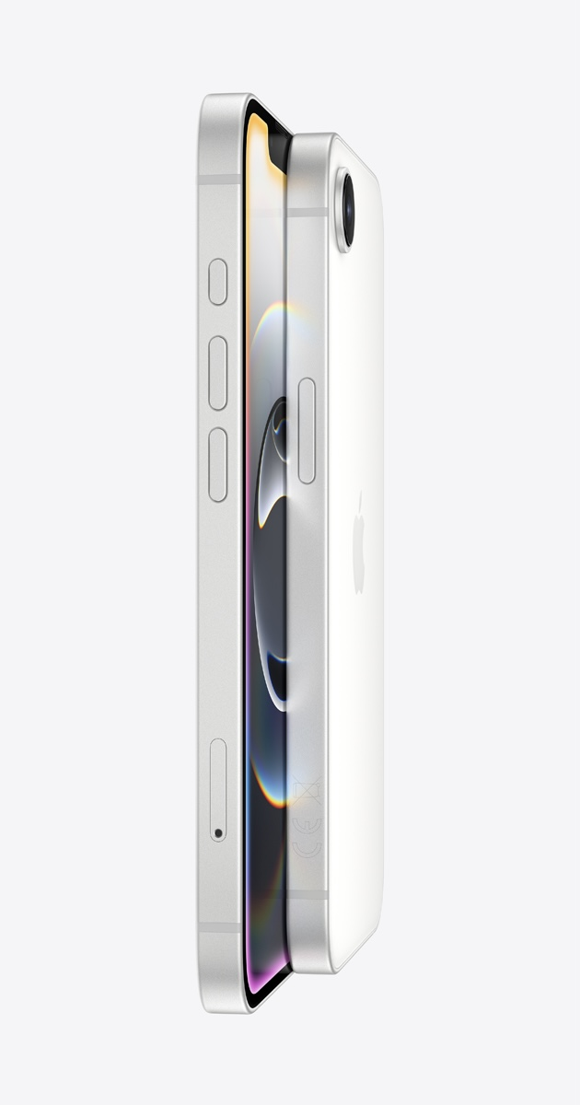
25mm
40mm
10mm
2mm
28mm
21mm

